Slide 1
Students to students to support website
I believe This website is very important for students all over the world. As well as for the developer who develop this website. Which I am going to explain on the next slide.

Slide 2
The Goal of this website
Students to Students support website
The aim of this website
Supporting students from all-over the world.
Connecting students based on the subjects they are learning.
Creating platform where students can chat and resolve there issues with other students or teachers.
Creating a platform where students can upload and download the documents.
Gaining more understanding about the web development in the process.
Owning the data for the future of developing other related applications of websites.
To design and deploy the website.
Create and connect to the database.
Gaining more understanding both for front end and backend web developing.

Slide 3
The machine language that I used to develop the website
The machine language that I used to develop the website
JavaScript
PHP
With HTML and CSS

Slide 4
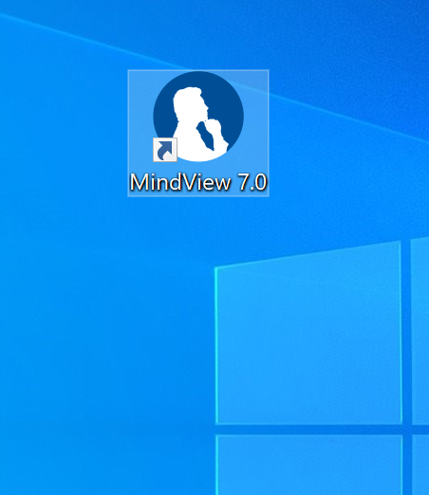
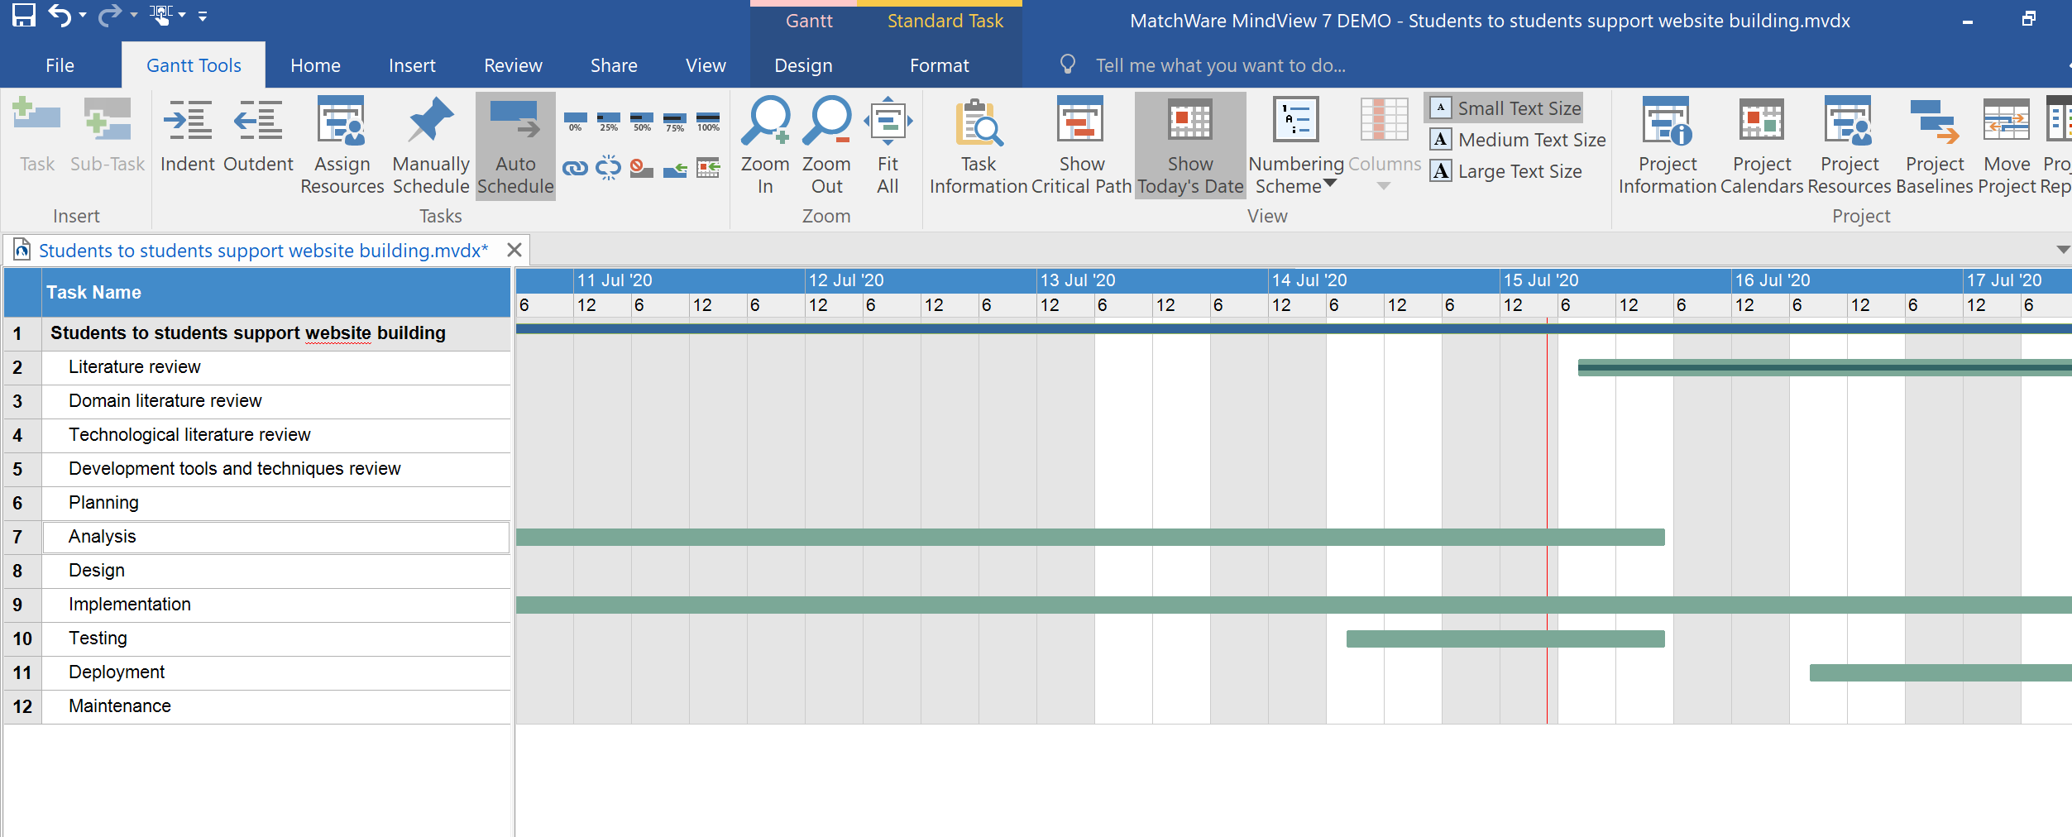
Tools I used to develop the website
mindView
mindView
The importance mindview is to create a gant chart.
Gant chart is very important to divide the project based on the time framework.

Slide 5
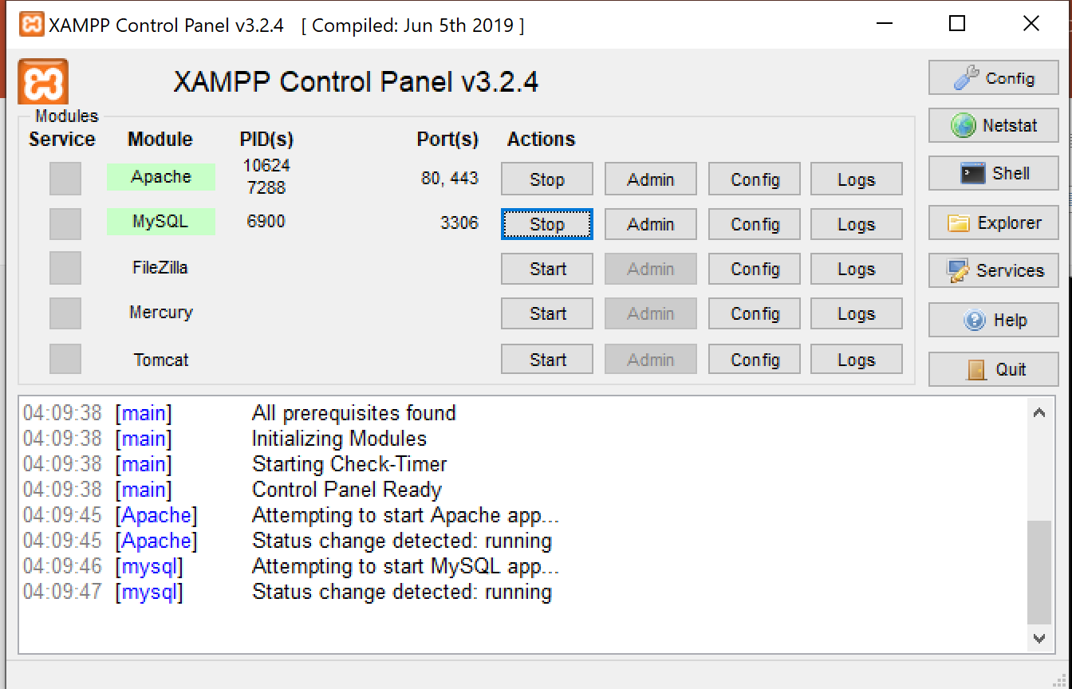
XAMPP
The importance of xampp for this project
X: cross platform: it help me to move my project from windows to mac
A:Apache server: The importance of apache server is to run most of the applications or software like PHP. It is the most usable webserver software across the world.
M: Maria DB: Maria DB is the popular database server that is open source and developed by original developers of MySQL.
P: PHP– Xampp supports PHP:PHP stands for PHP Hypertext Processor(earlier it was known as Personal Home Page), It provides an environment for web development. This is a server-side scripting language.
P: PERL – Xampp supports PERL.
PERL(Practical Extraction and reporting language) is a high-level general-purpose programming language. It is used in developing web applications.

Slide 6
The last Tool that used to develop the website
SublimText3
The main benefit of Sublime text is to write the code in multiple languages.
So I used it to write the code.

Slide 7
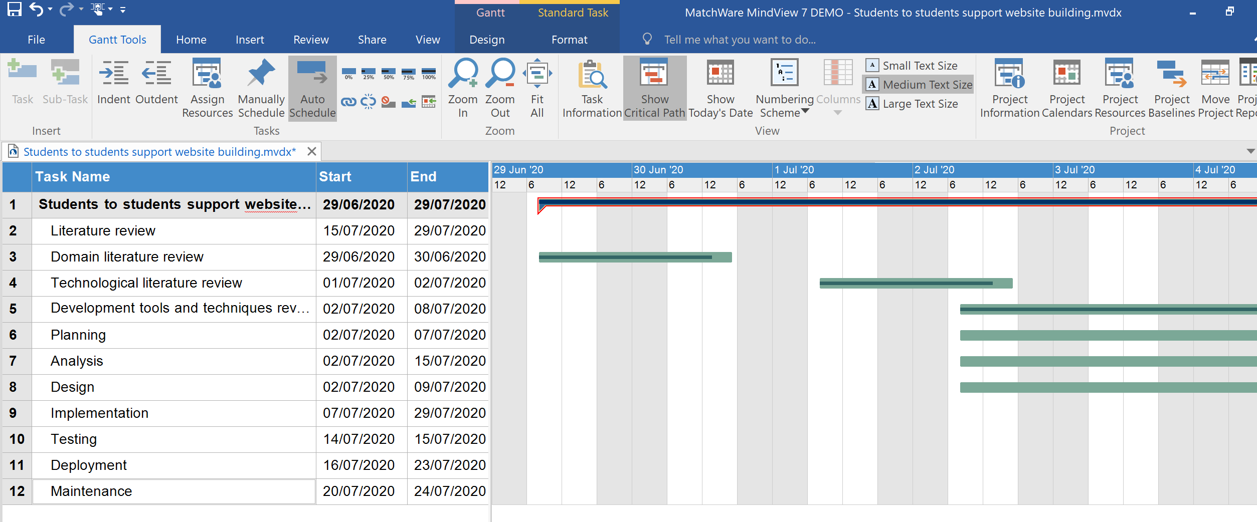
Website planning

Slide 8
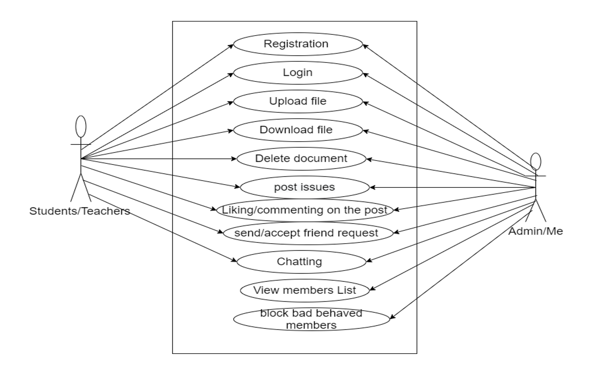
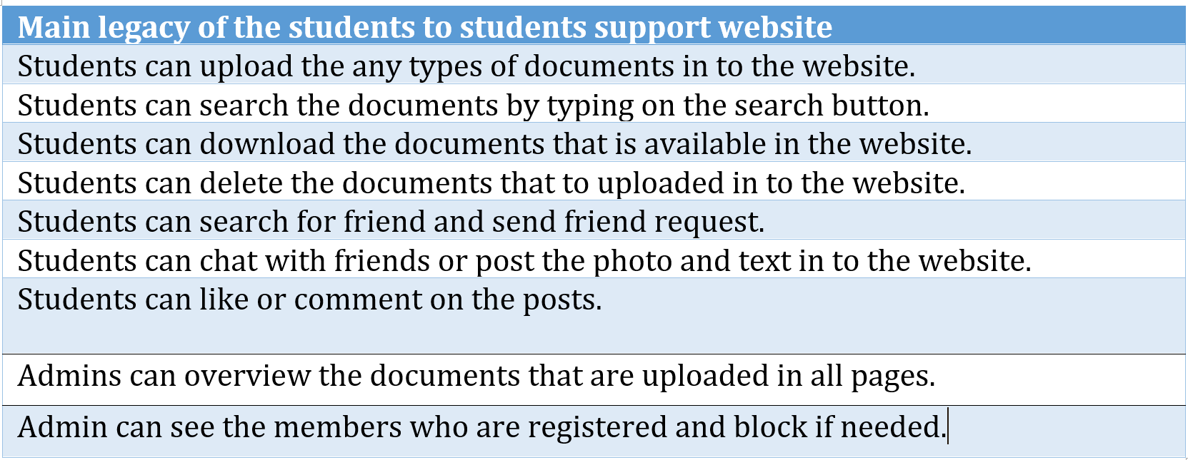
System analysist

Slide 9
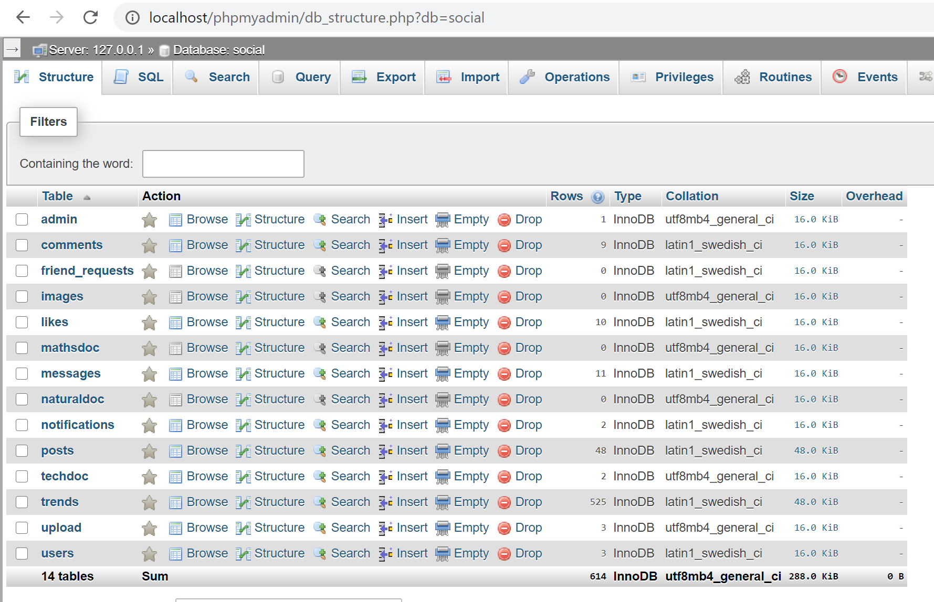
Website Implementation

Slide 10
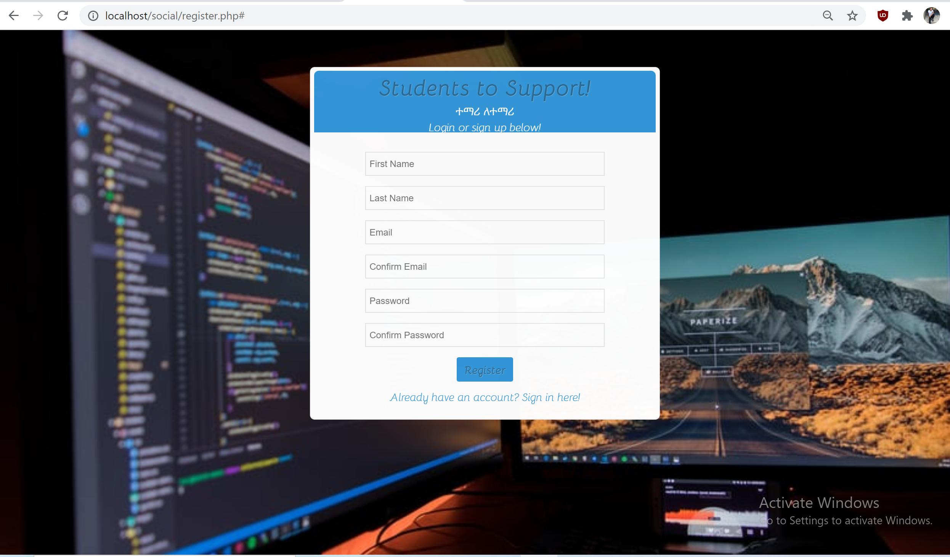
Registration Page

Slide 11
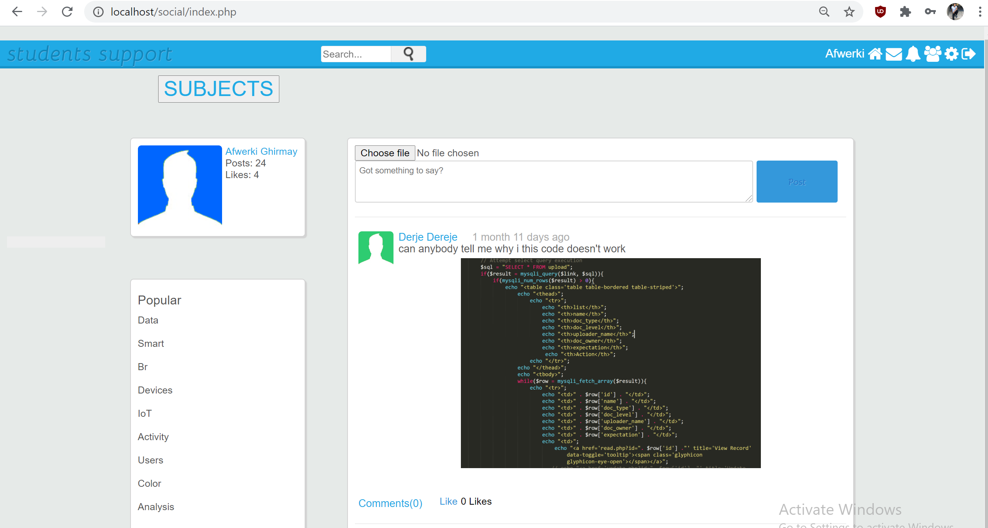
Index page

Slide 12
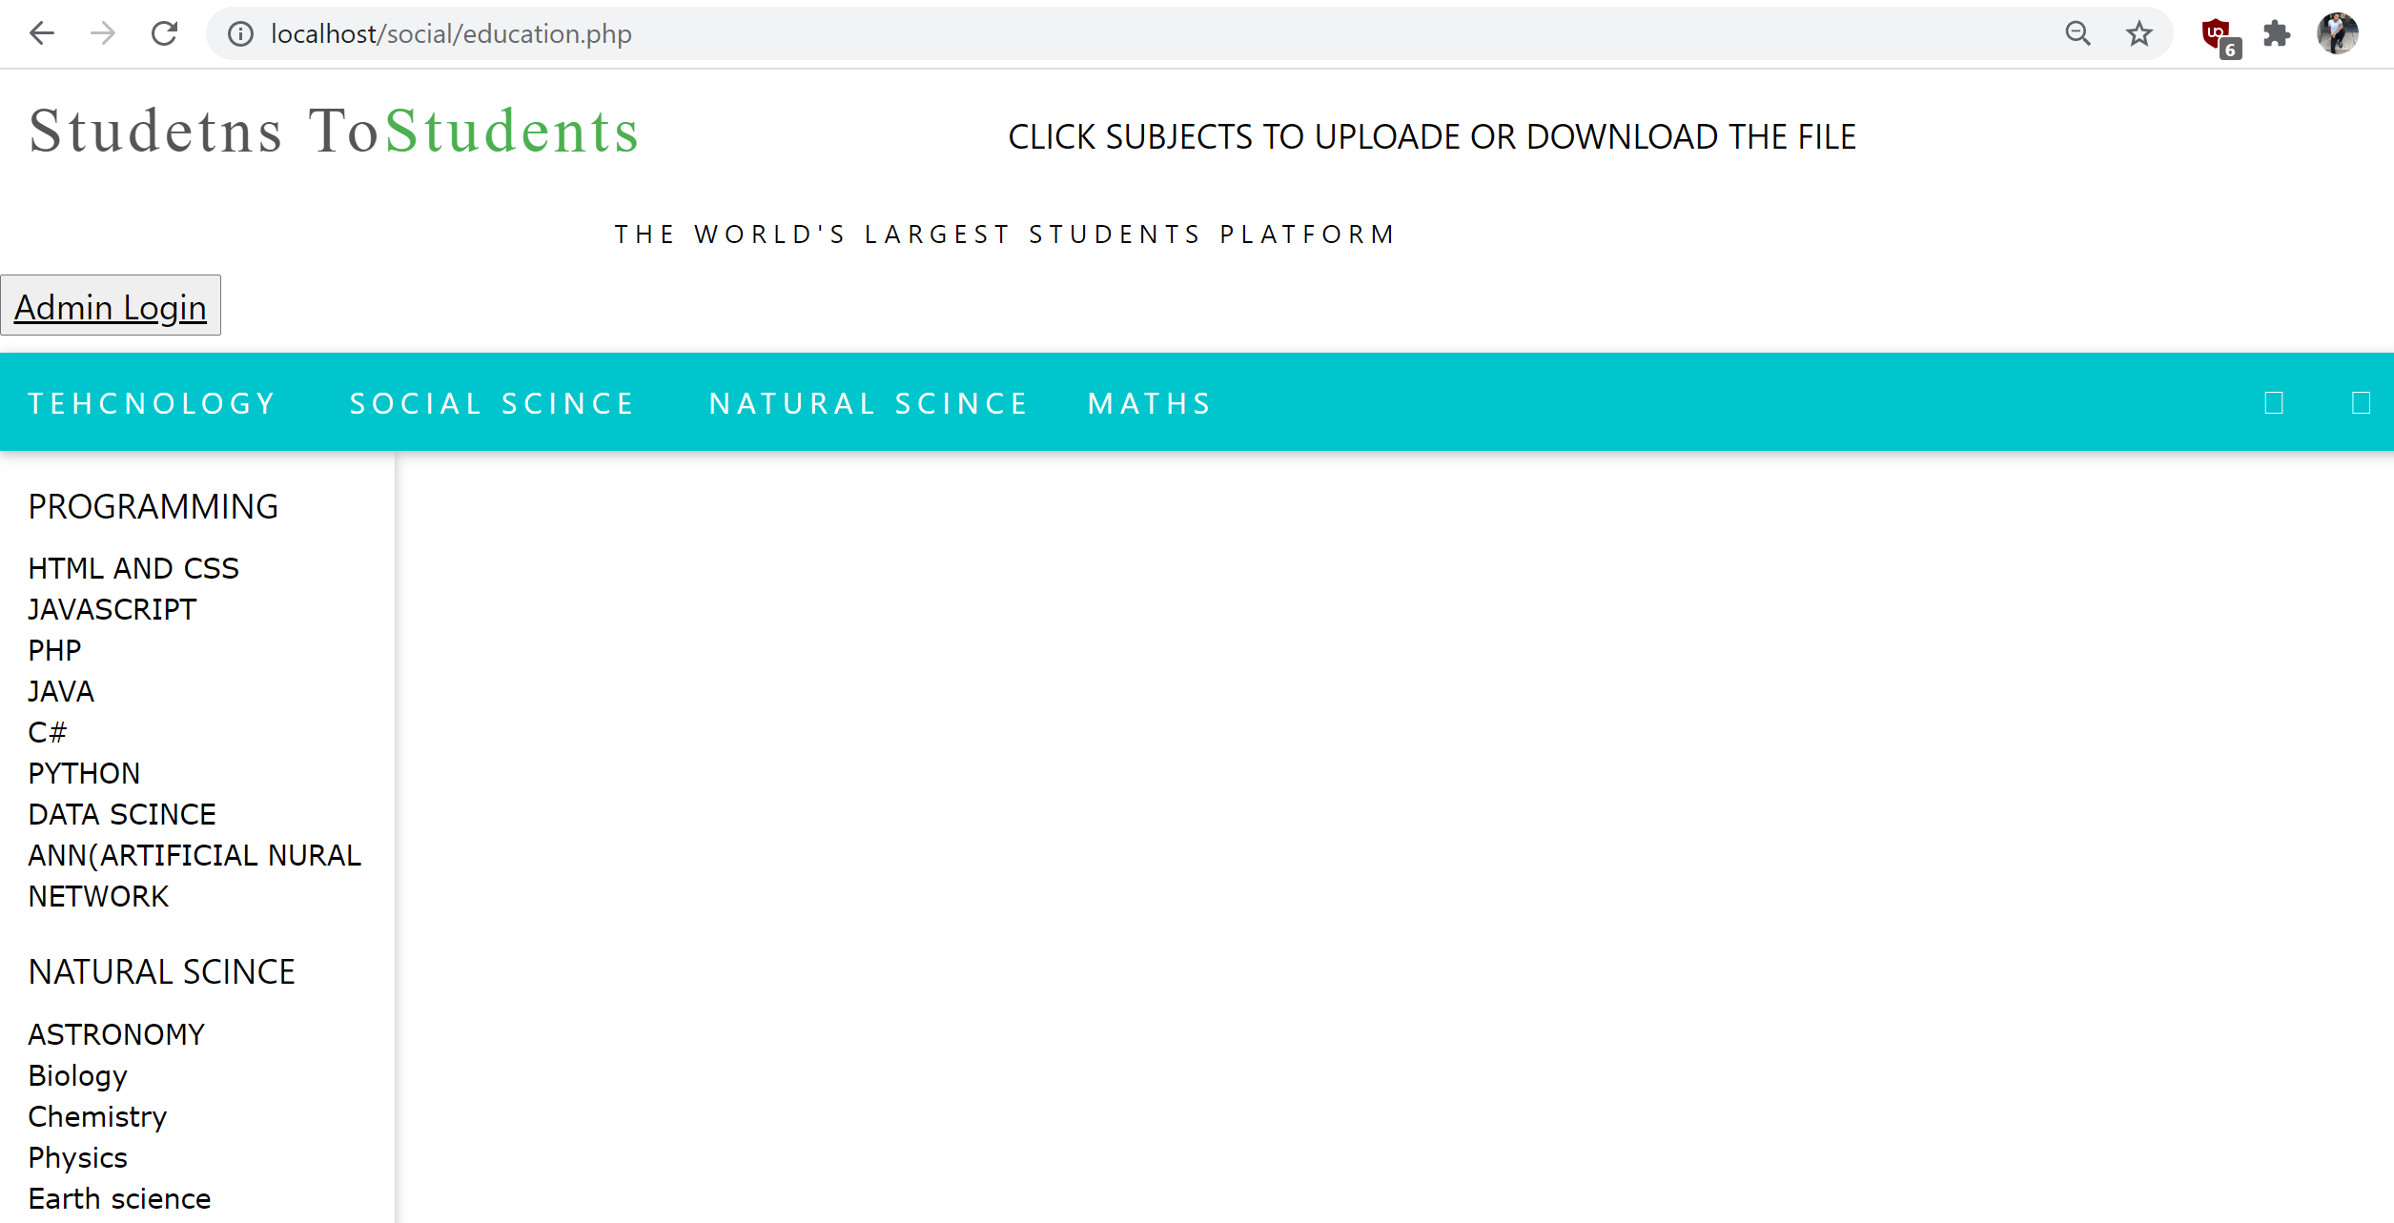
Subjects Pages

Slide 13
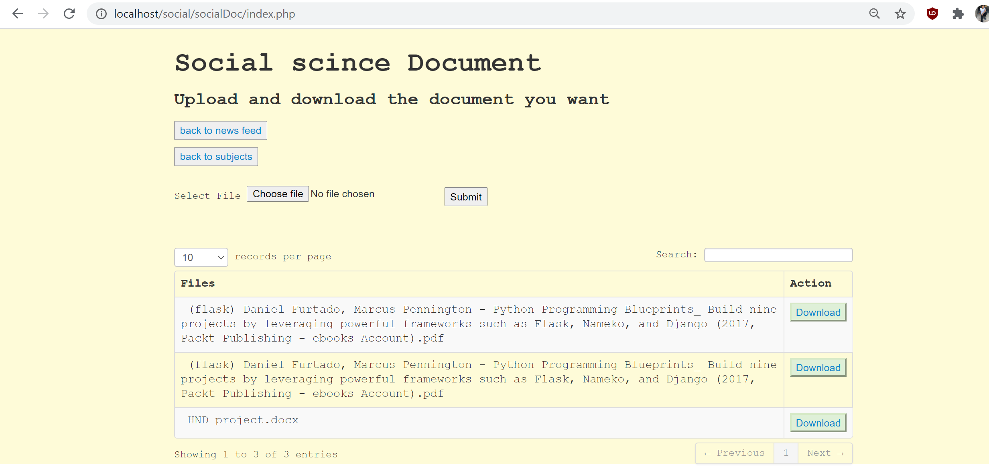
Documents Page

Slide 14
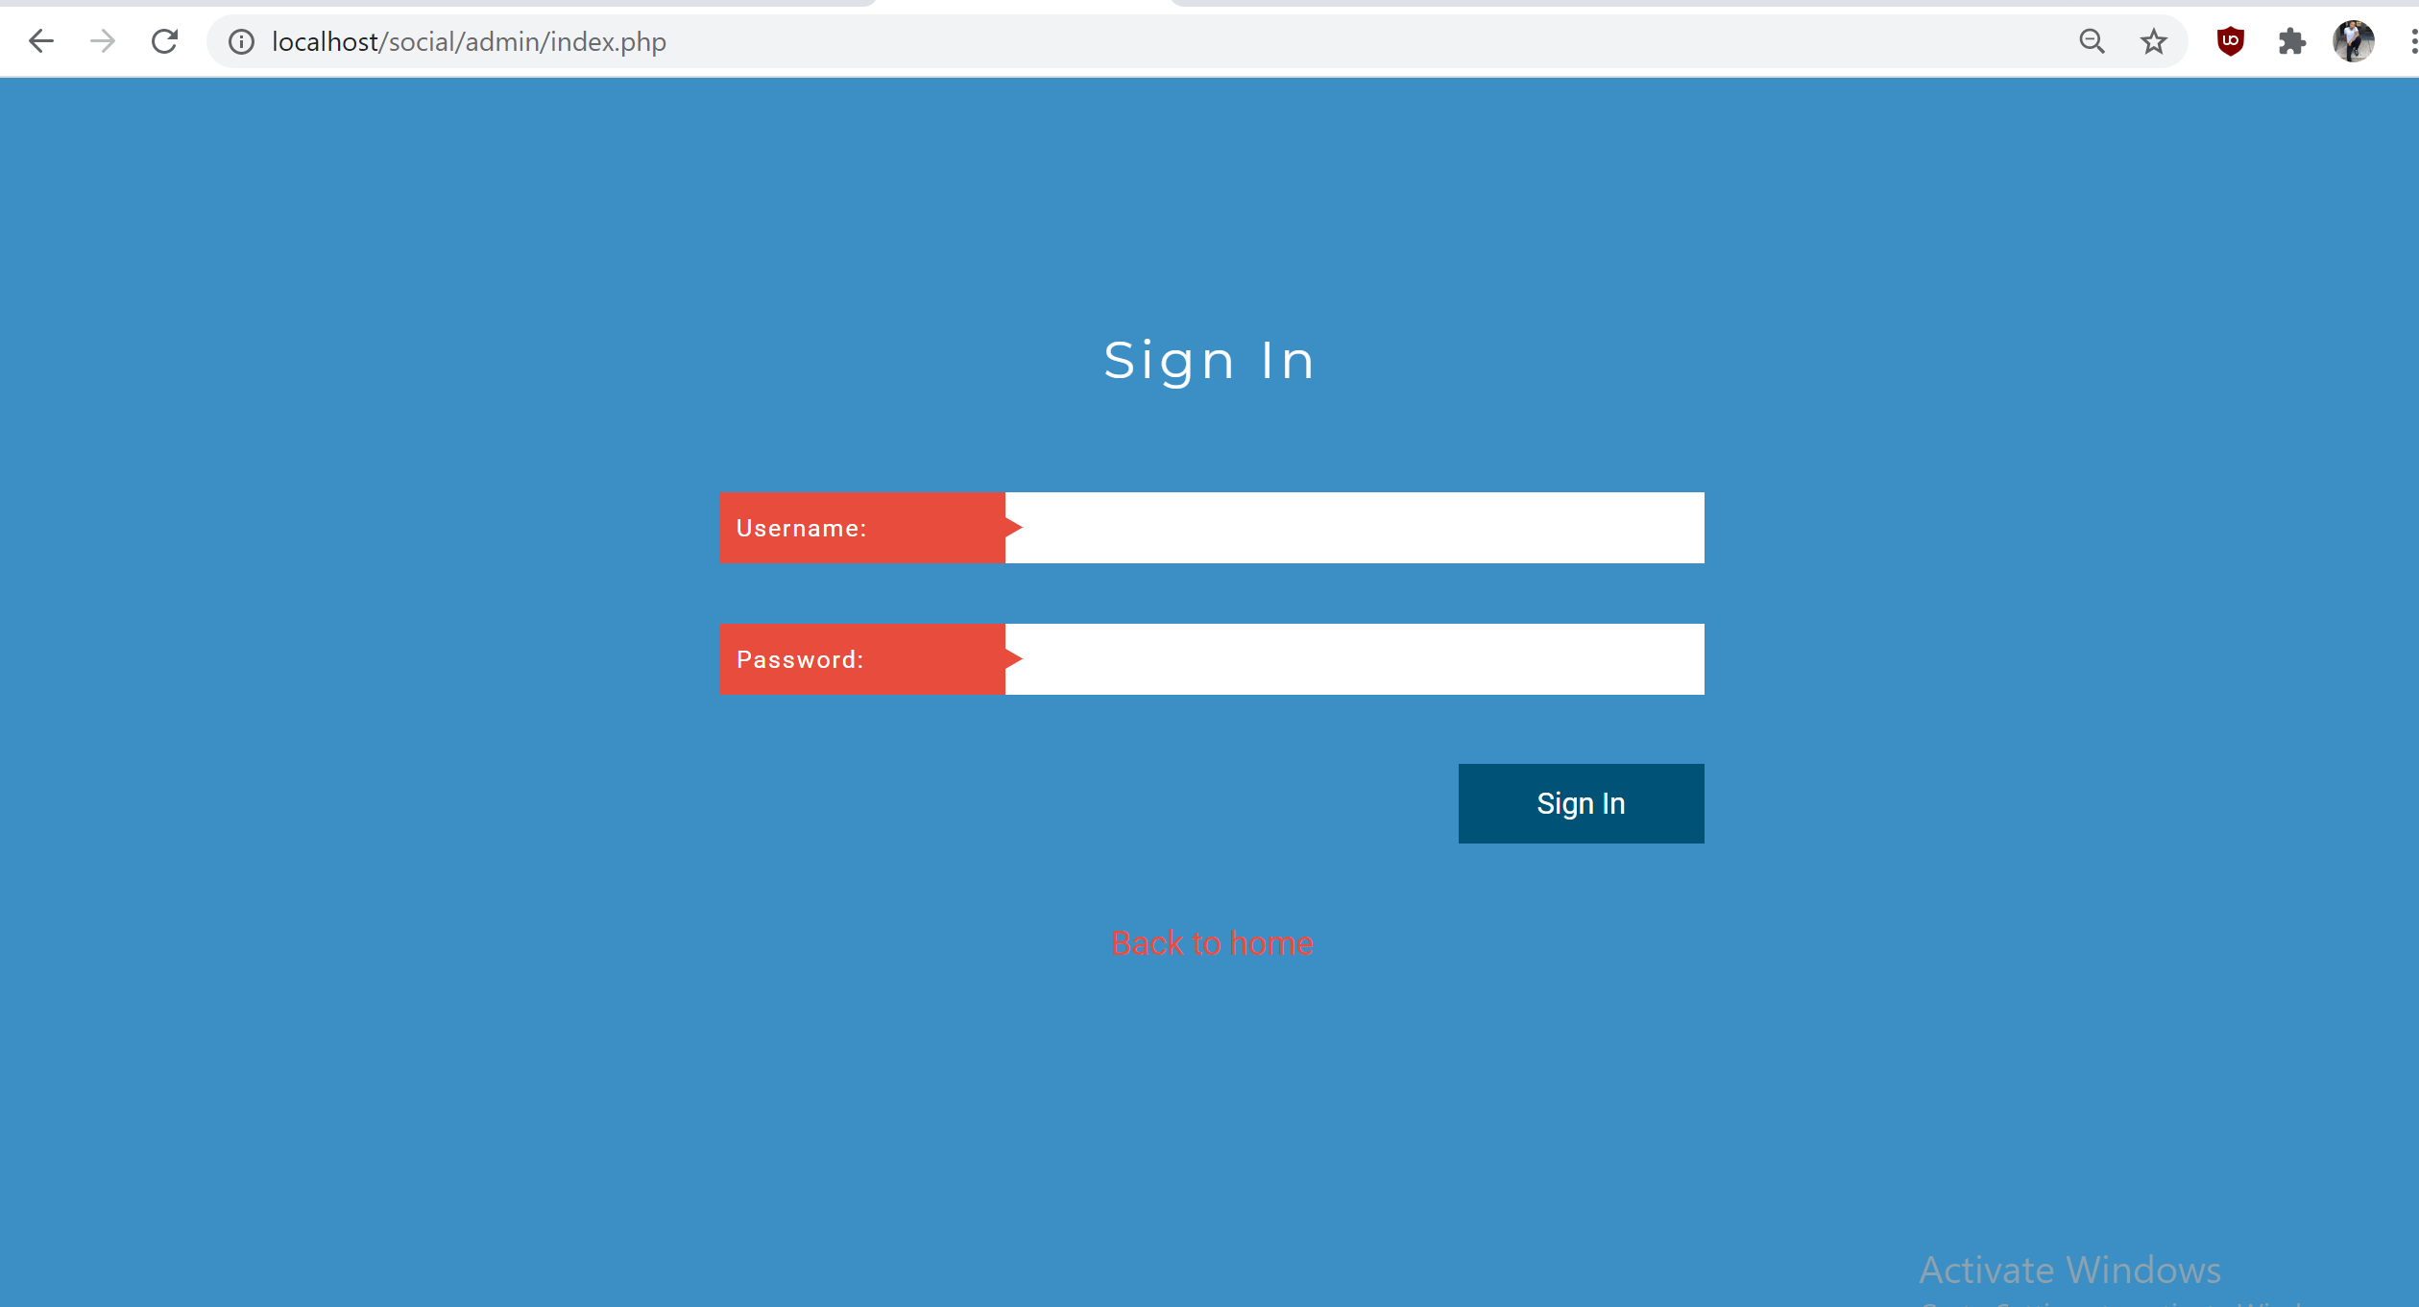
Admin Login page

Slide 15
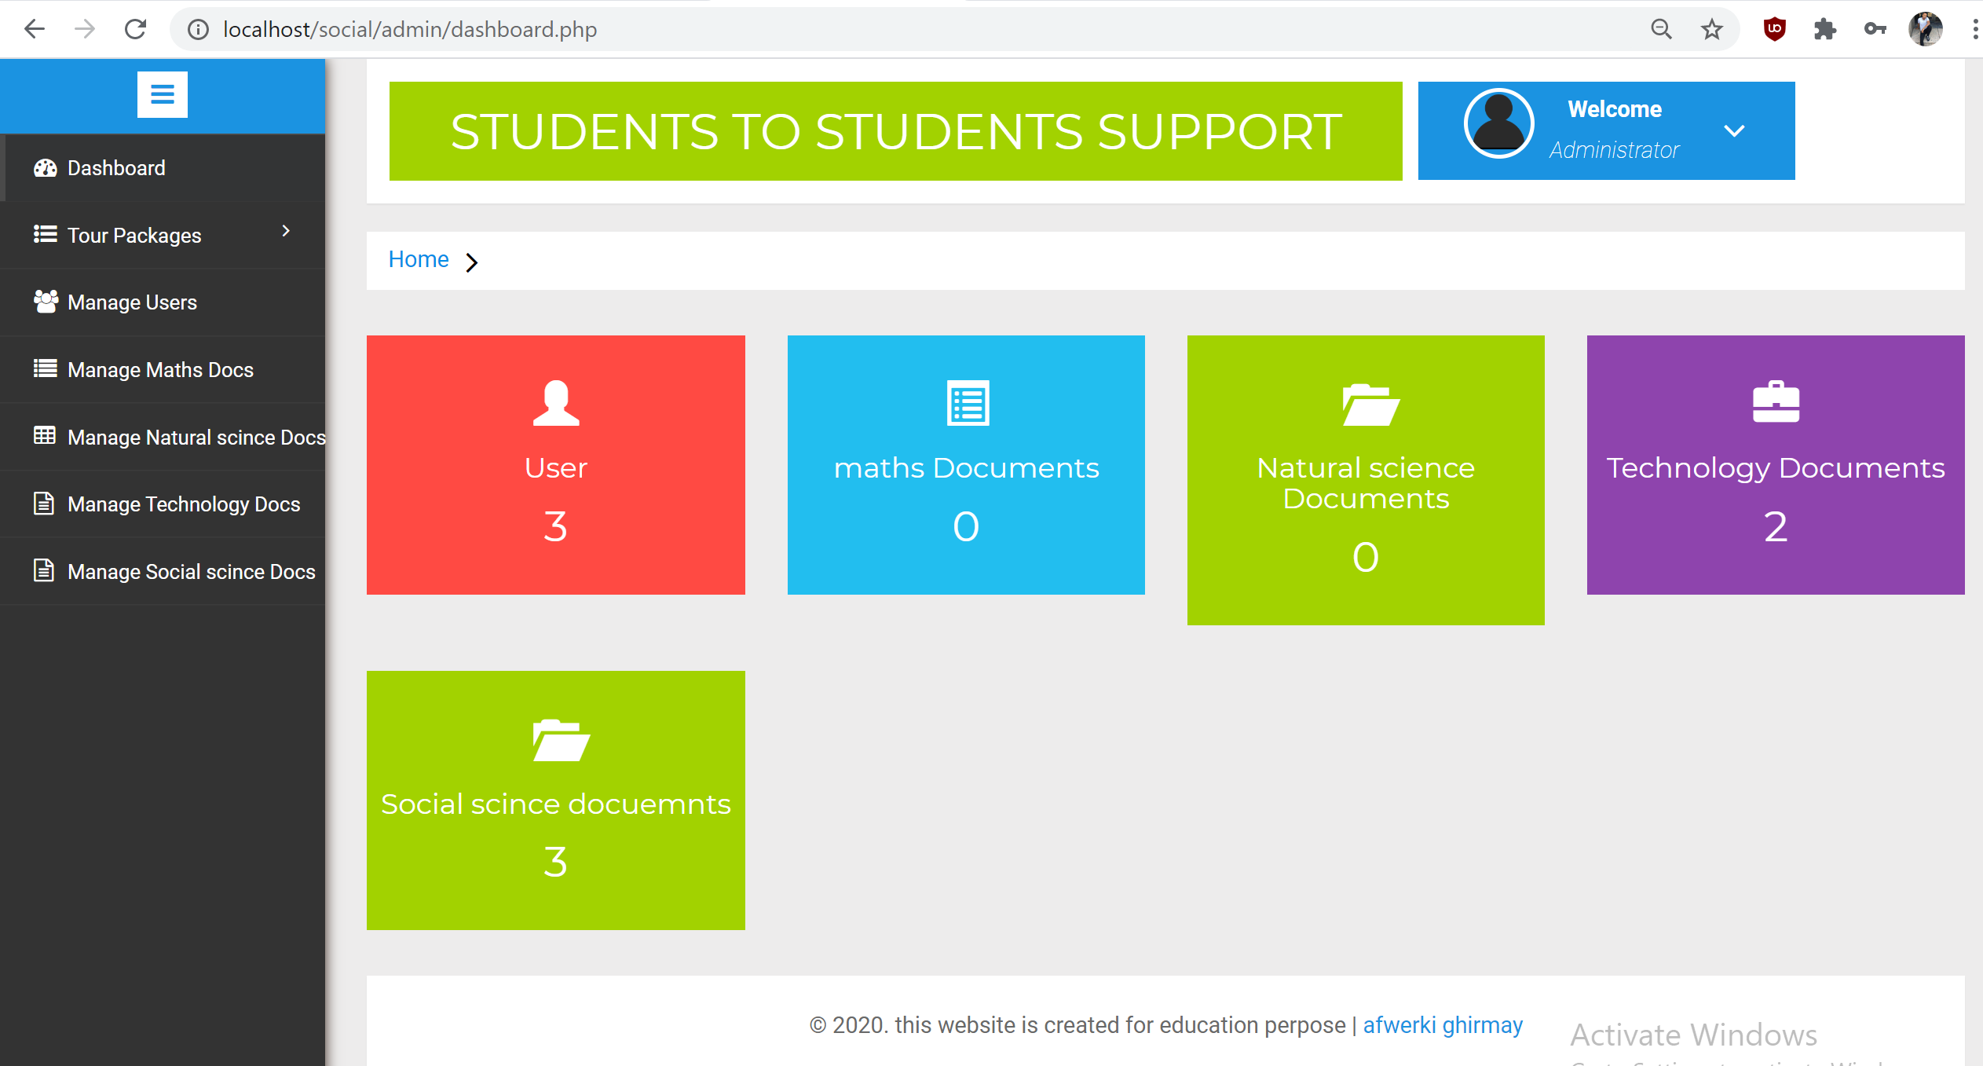
Admin dashboard

Slide 16
Website testing
Hosting the website
Managing the website
Website Security are on the process

